Slide 1

Cost-sensitive Boosting algorithms: Do we really need them?
Machine Learning Journal, Vol. 104, Issue 2, Sept 2016
Nikolaos Nikolaou, Narayanan Edakunni, Meelis Kull, Peter Flach and Gavin Brown

Slide 2
Adaboost (Freund & Schapire 1997)
Ensemble method - rich theoretical depth.
Train models sequentially.
Each model focuses on examples previously misclassified.
Combine by majority vote.

Slide 3
Majority voting confidence in classifier t
Distribution update
Majority vote on test example x’

Slide 4
Adaboost
How will it work on cost sensitive problems?
i.e. with differing cost for a False Positive / False Negative …
…does it minimize the expected cost?

Slide 5
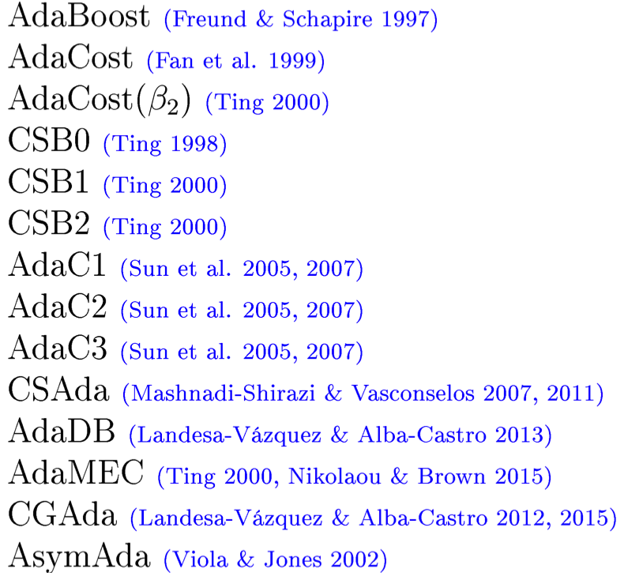
Cost sensitive Adaboost…
15+ boosting variants over 20 years
Some re-invented multiple times
Most proposed as heuristic modifications to original AdaBoost
Many treat FP/FN costs as hyperparameters

Slide 6
A step back… Why is Adaboost interesting?
Functional Gradient Descent (Mason et al., 2000)
Decision Theory (Freund & Schapire, 1997)
Margin Theory (Schapire et al., 1998)
Probabilistic Modelling (Lebanon & Lafferty 2001; Edakunni et al 2011)

Slide 7

So for a cost sensitive boosting algorithm…
My new algorithm
Functional Gradient Descent
Decision Theory
Margin Theory
Probabilistic Modelling
“Does my new algorithm
still follow from each?”

Slide 8
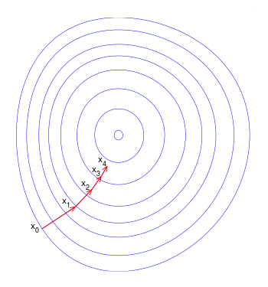
Functional Gradient Descent
Direction in function space
Step size
Property: FGD-consistency
Are the voting weights and distribution updates consistent with each other?
(i.e. both derivable from FGD on a given loss)

Slide 9

Decision Theory
Ideally: Assign each example to risk-minimizing class.
>
FP
FN
Property: Cost-consistency
Does the algorithm use the above (Bayes optimal)
rule to make decisions?
(assuming good probability estimates)

Slide 10
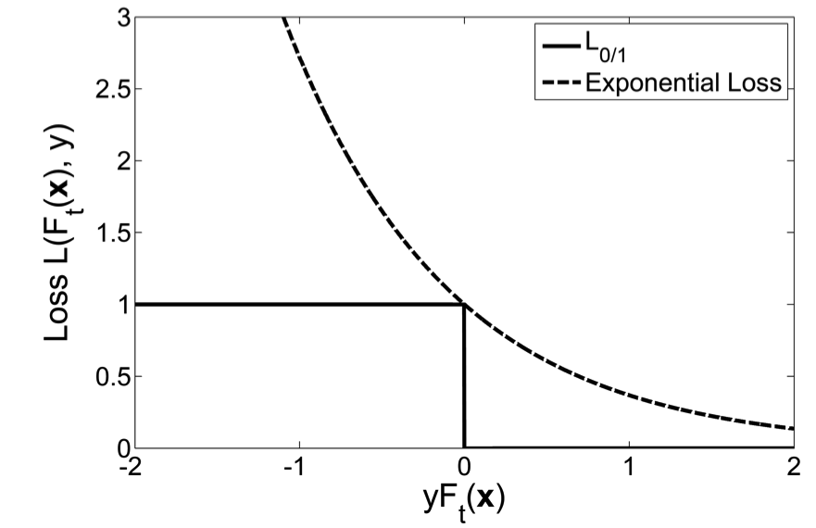
Margin Theory
Large margins encourage small generalization error.
Adaboost promotes large margins.

Slide 11
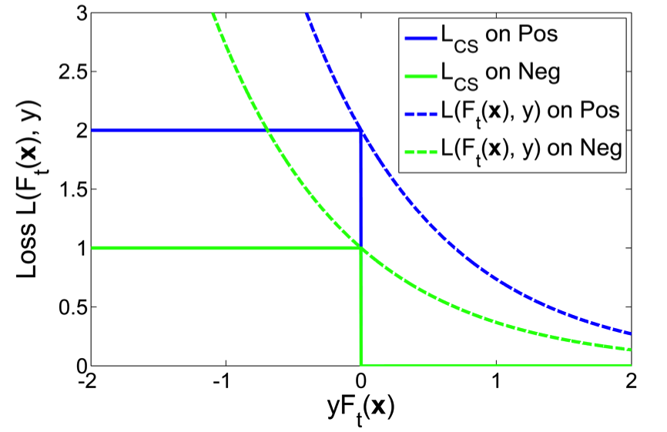
Margin Theory – with costs…
Different surrogate losses for each class.

Slide 12
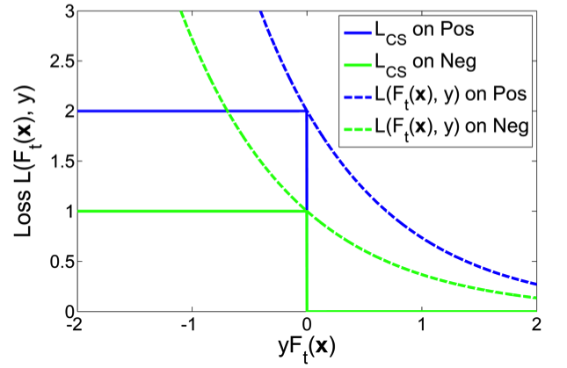
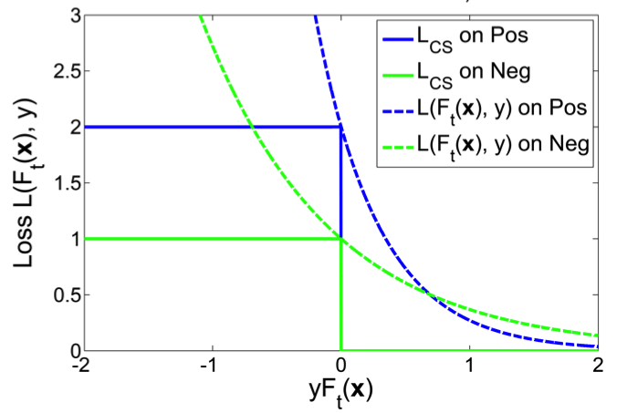
So for a cost sensitive boosting algorithm…
We expect this to be the case.
But some algorithms do this…
Property: Asymmetry preservation
Does the loss function preserve the relative importance of each class, for all margin values?

Slide 13
Probabilistic Models
‘AdaBoost does not produce good probability estimates.’
Niculescu-Mizil & Caruana, 2005
‘AdaBoost is successful at [..] classification [..] but not class probabilities.’
Mease et al., 2007
‘This increasing tendency of [the margin] impacts the probability estimates by causing them to quickly diverge to 0 and 1.’ Mease & Wyner, 2008

Slide 14
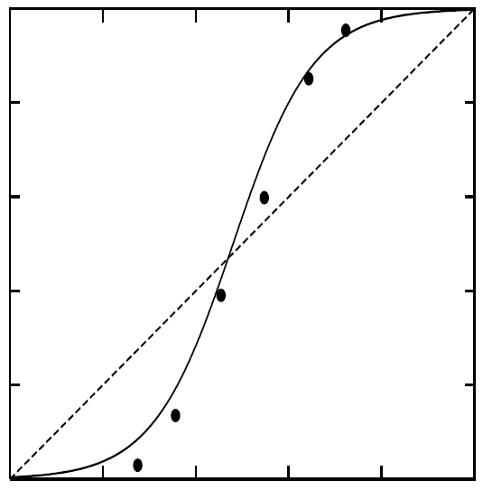
Probabilistic Models
Adaboost tends to produce over-
or under-estimates of probabilities.
Adaboost output
(score)
Empirically Observed Probability
Property: Calibrated estimates
Does the algorithm generate “calibrated”
probability estimates?

Slide 15
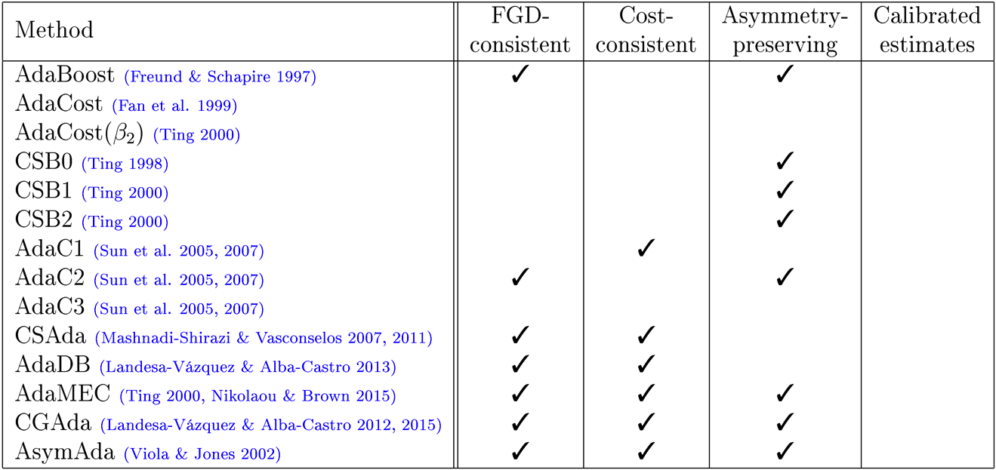
The results are in…
All algorithms produce uncalibrated probability estimates!
So could we just calibrate these last three? We use “Platt scaling”.

Slide 16
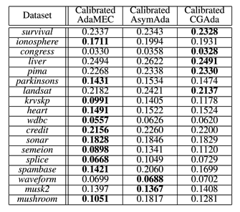
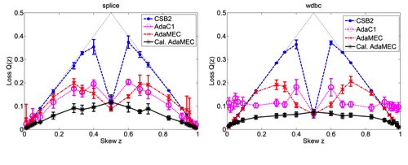
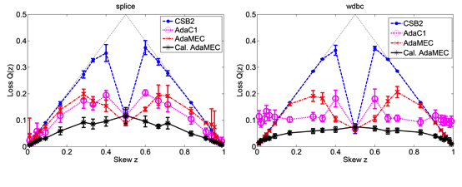
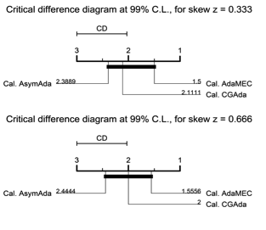
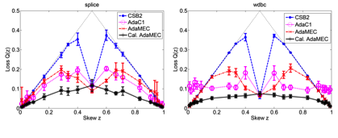
Experiments
15 algorithms.
18 datasets.
21 degrees of cost imbalance.

Slide 17
In summary…
Average Brier Score Rank
AdaMEC, CGAda & AsymAda outperform all others.
Their calibrated versions outperform the uncalibrated ones

Slide 18
In summary…
“Calibrated-AdaMEC” was one of the top methods.
1. Take original Adaboost.
2. Calibrate it (we use Platt scaling)
3. Shift the decision threshold….
Consistent with all theory perspectives.
No extra hyperparameters added.
No need to retrain if cost ratio changes.
Consistently top (or joint top) in empirical comparisons.

Slide 19
Conclusions
We analyzed the cost-sensitive boosting literature
… 15+ variants over 20 years, from 4 different theoretical perspectives
“Cost sensitive” modifications to the original Adaboost are not needed...
… if the scores are properly calibrated,
and the decision rule is shifted according to the cost matrix.
Thank you! Grazie!

Slide 20
Area under the Brier (cost) curve
Look at the pareto front!

Slide 21
A closer look at the Brier Curves.

